Slide 1
Sample Management in VEEVA
LEVEL – PL3
20-07-2023

Slide 2
About the Author
Created By: | Prashant, Sourav Bhattacharya, Supriyo Saha
Credential Information: | Consultant CRM, Sr. Consultant CRM – EAS Salesforce
Version and Date: | V 0.9 :20-July-2023, V1.0: July-2023:Updated with Lightning UI
Modified By: | Sneha Kate

Slide 3

Overview
In Life Sciences industry, when a Sales Representative visits an Account to detail about a product, sometimes the account is provided with some samples of the Product
In several countries, the sampling of Product is highly regulated by law
This document provides some insight into the Sample Management features available in VEEVA CRM

Slide 4

Objectives
After completing this chapter, you will learn to:
  Define VEEVA Sample Management Data Model
  Define Sample Lot and Lot Catalog
  Explain various Sample Transactions
  Describe My Samples Tab
  Describe Sample Limit

Slide 5

Do You Know…1
VEEVA CRM supports Sample Management solution by following relevant compliance solutions including capturing of Electronic Signature for both paper-based and electronic-based sampling of Controlled and Non-Controlled Substances
The Sample Lot object in VEEVA CRM contains all Lot #s for products that are available to users while the Lot Catalog contains all Samples and their corresponding Lot #s that are available to the entire organization
In VEEVA CRM Sample Lots can be created from the Lot Catalog Tab by using the Create Sample Lots button
Five types of Sample Transactions exist in VEEVA CRM:
  Adjustment, Return, Disbursement, Transfer and Receipt

Slide 6
Do You Know..2
The My Samples tab displays a list of sample inventory records
The User can select the New Record button in order to create a new inventory or select any existing inventory for seeing details
Sample Limits provide a method to regulate and enforce the Sample Quantity disbursed
The number of samples disbursed to an Account over a specific time period is regulated by several companies

Slide 7
Sample Management in VEEVA
VEEVA Sample Management Data Model
20-07-2023

Slide 8
Introduction…1
VEEVA CRM supports Sample Management solution by following relevant compliance including capturing of Electronic Signature for both paper-based and electronic-based sampling of Controlled and Non-Controlled Substances
Configuring Sample Management solution in VEEVA requires configuration of the following individual and related components:
  Sample Lots
  My Samples
  Sample Transactions
  Sample Limits
  Sample Inventories
In this course we will discuss about Sample Lots, Sample Transactions and Sample Limits

Slide 9
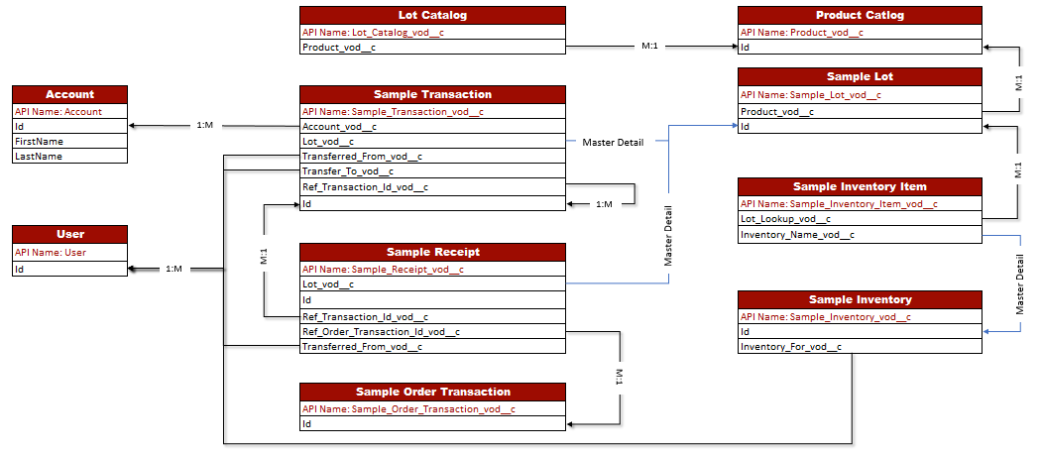
Data Model…1

Slide 10
Data Model…2
Object | Key Feature
User | Mainly sales rep of the client company who disburses sample to the HCP
Account | HCP who receives the sample products
Product Catalog (Product_vod__c) | This object stores all product data including detail and sample products
Rep Roster (Rep_Roster_vod__c) | The Rep Roster object stores the relationship between users and territories, as well as user-related HR information, for example address, etc. The Address fields in Rep Roster are utilized to maintain Sample Storage information for all Sampling Reps to meet compliance regulations
Lot Catalog (Lot_Catalog_vod__c) | Lot Catalog contains a list of all Samples and Lot #s available for Sample Transactions for the entire organization. The Lot Catalog acts as the base for user-specific Sample Lot creation
Sample Lot (Sample_Lot_vod__c) | Sample Lot contains a list of user specific Samples and Lot #s available for Sample Transactions. Sample Lots are auto-created for Users based on Transfer Sample Transactions from one user to another user as well as from the Create Sample Lots button on Lot Catalog
Sample Transaction (Sample_Transaction_vod__c) | Sample Transaction maintains and controls all transactional data related to Samples for PDMA and FDA compliance
Sample Receipt (Sample_Receipt_vod__c) | Sample Receipt contains all Pending Sample Receipts for users. A Sample Receipt is created by the Sample_Transaction_vod trigger on Sample Transaction on the Submit of a Transfer Sample Transaction

Slide 11
Sample Setup
Admin need to follow the below steps to configure sampling for a new product:
1. Create Detail and
Sample Product
2. Give users access to Detail products through user’s ‘My Setup’
3. Create a Rep Roster record for the user
7. User Starts Recording calls with Active Sample products
6. User confirm receipt of the sample shipment
5. Create Sample Transfer for each user
4. Create a Sample Lot

Slide 12
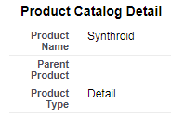
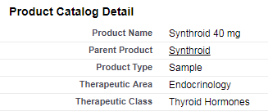
1. Product Catalog
Admin need to configure the products first for enabling sampling. VEEVA or Sample admin first need to configure the detail product, and then the same product associated with the detail one
  Create Detail and Sample products
    Go to All Tabs → Product Catalog
  Create Detail product first
    Leave Parent Product blank as detail is the top level product
    The Company Product checkbox must be selected
  Create a product of Type Sample
    Set the Parent Product to the Detail product
    The Company Product checkbox must be selected for the sample record
    The Manufacturer must be populated for the Sample Record. This information is used by the Signature Capture Screen

Slide 13

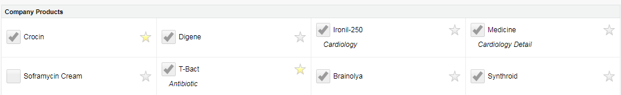
2.My Setup Products
Once the detail and sample product is created, admin need to assign the detail product to the user through ‘My setup’
  Give users access to Detail products
    Go to All Tabs → My Setup
    Search for and edit each user’s My Setup
    Ensure the user is having access to the detail product, so that he can discuss the same during a call

Slide 14
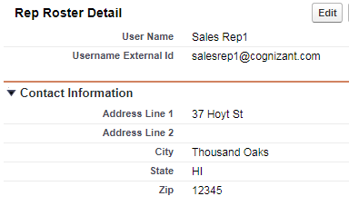

3.Rep Roster
Admin must configure a rep roster for each address for the user to receive the sample product at his address
  Configure the Rep Roster for each user
    Go to All Tabs → Rep Roster
    Modify or create a Rep Roster for each user
  Rep Roster address should be the location of the user’s storage locker
  Rep Roster Username External Id must match user’s SFDC username

Slide 15
Sample Management in VEEVA
Sample Lot and Lot Catalog
20-07-2023

Slide 16
Sample Lot: Introduction…1
The Sample Lot object in VEEVA CRM contains all Lot #s for products that are available to users. The records in this object are visible only to the record owners
The unique key constraint to the Sample Lot object is a combination of Lot #, the Sample name, and the Owner fields
The Sample Lot object has a master-detail relationship with the Sample Transactions object in the detail side
The Sample Lot object is governed by strict security measures preventing users from updating or deleting Sample Lots
Administrators can be provided with access to delete Sample Lots but a trigger prevents the same to be deleted if Sample Transactions exist for the Sample Lot record that is being deleted

Slide 17
Sample Lot: Introduction…2
Only the Active Sample Lots are displayed in My Sample page for a user
However, inactive Sample Lots which have been modified in last 60 days are also available in the list – this allows users to deselect a Sample Lot and select it again in case of user error
Note:
  Active Sample Lots display on all calls even if the user does not have access to the parent product in their My Setup
  Enabling the ENABLE_NEG_SAMPLE_INDICATOR VEEVA Setting will display an indicator when a sample drop or transfer would create a negative balance of inventory for a given sample lot

Slide 18
Sample Lot: Lot Catalog…1
The Lot Catalog contains all Samples and their corresponding Lot #s that are available to the entire organization. Administrators use Log Catalog to generate Sample Lots for users
The Lot Catalog in VEEVA CRM can be configured using the below steps:
  Create Samples in Product Catalog
  The Name of the Sample created in the previous step need to be included in the Sample picklist in the Lot Catalog object. Please note that the picklist value must be an exact literal match of the Sample Name created in Product Catalog
Lot catalog can be created in any of the 3 methods below:
  Manual creation from application
  Data loading via the Data Loader tool
  Integration to a back-office system or 3rd party application through the Salesforce API

Slide 19
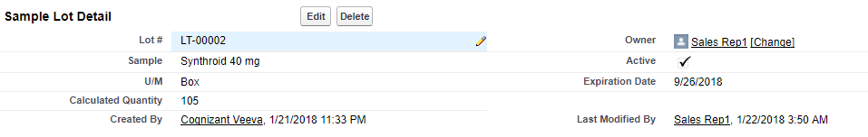
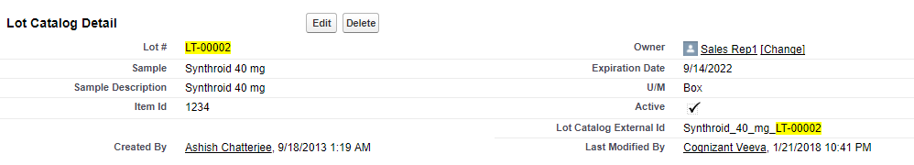
Sample Lot: Lot Catalog…2
Sample Lot
Lot Catalog

Slide 20
Creating Sample Lots: from Lot Catalog Tab
In VEEVA CRM Sample Lots can be created from the Lot Catalog Tab by using the Create Sample Lots button
This button allows an administrator to select multiple Lot Catalog records and generate Sample Lot records for a particular user
In order to provide user, the permission to use the Create Sample Lots button effectively, user should be given access to
  the Visualforce page CreateSampleLots_vod and
  the Apex Class VOD_GetRecordIds

Slide 21
Sample Management in VEEVA
Sample Transaction
20-07-2023

Slide 22
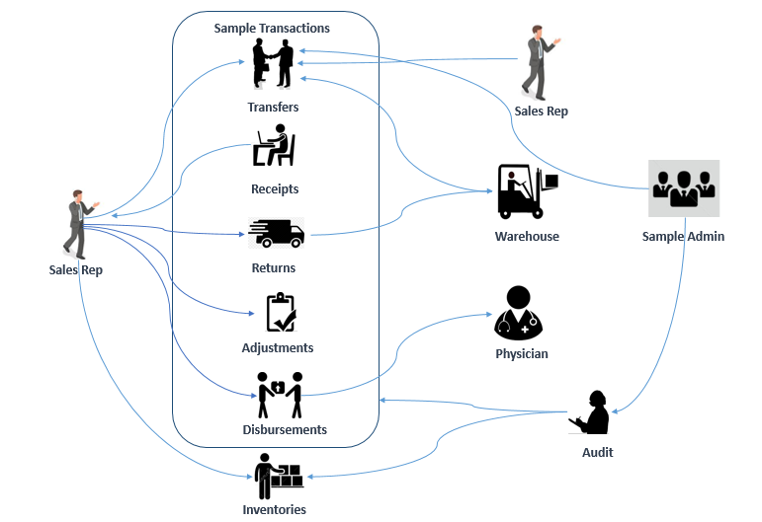
Sample Transactions

Slide 23
Sample Transactions: Introduction…1
Five types of Sample Transactions exist in VEEVA CRM are:
  Adjustment
  Return
  Disbursement
  Transfer
  Receipt
In Sample Transactions object the above Transaction Types are controlled by Record Type – one for each transaction type
Sample Transactions are stored in the object Sample_Transaction_vod__c which is on the detail side of a master-detail relationship with Sample Lot object

Slide 24
Sample Transactions: Introduction…2
To meet certain compliance requirements an Apex trigger exists on the Sample Transaction object to prevent the deletion of Sample Transaction records if the Status field of the Sample Transaction record is equal to Submitted
Administrators can be provided with permissions to unlock and edit/delete a Sample Transaction record
All modifications and deletions of Sample Transaction records are logged in the Sample Transaction Audit object, which is read-only, to provide historical visibility of modifications and deletes of Sample Transaction records

Slide 25
Grouping SampleTransactions…1
VEEVA CRM allows users to enter multiple sample lot line items as one transaction
In order to configure this, the fields Group_Transaction_Id_vod and zvod_Sample_Lines_vod need to be added to the Sample Transactions object
Using this functionality, user can add additional samples using the Add Line Item link, as well as delete lines using the Del link. The Add Line Item and Del link are displayed in edit view mode only
The zvod_Sample_Lines_vod field needs to be added to the page layout
If multi-line Sample Transaction functionality is enabled, the Group_Transaction_Id_vod field is populated irrespective of whether the sample transaction contains single or multiple lines
This field value groups the sample transactions together
The Group_Transaction_Id_vod field need to be added to Sample Transaction Audit object as well

Slide 26
Grouping Sample Transactions…2
Note:
  There is a limit of 10 lines per sample transaction
  If a sample transaction is unlocked that has the Group_Transaction_Id_vod field populated, then all sample transactions related to that group will be unlocked

Slide 27
Sample Management in VEEVA
My Samples Tab
20-07-2023

Slide 28
My Samples…1
iRep supports the creation of sample inventories offline. Selecting the My Samples tab displays a list of sample inventory records
The User can select the New Record button in order to create a new inventory or select any existing inventory for seeing details
However, Sample inventories can only be submitted online
My Samples Page Tab Icon
  We can configure the icon and header bar related with My Samples tab within the online VEEVA CRM application by using two VEEVA Messages:
    MY_SAMPLES_CONFIRM_COLOR - contains the HTML color code for the header bar
    MY_SAMPLES_LAYOUT_VIEW - contains the Salesforce css class name for the page
  This functionality is deactivated by default

Slide 29
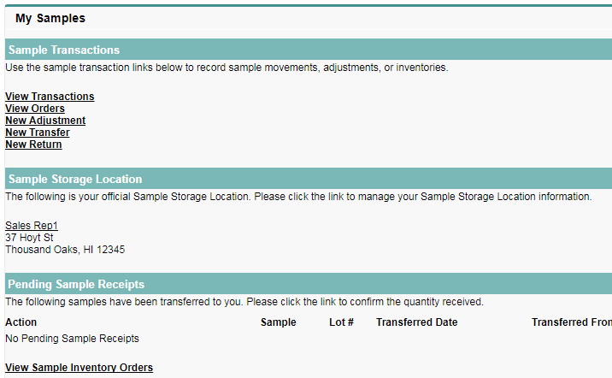
My Samples…2
User can manage different types of transactions from ‘My Samples’ tab
29

Slide 30
Transfer Sample Transactions…1
Admin or Users create a Transfer Sample Transaction when he needs to transfer a quantity of a Sample Lot to another user
The Transfer to field for a Transfer Sample Transaction indicates the user that is the recipient
The Sample Transaction object has an Apex trigger which performs the following actions on submission of a Transfer Sample Transaction:
  Sample Lot being transferred is created/updated for the Transfer to User of the Transfer
  A Sample Receipt record is created for the Transfer to User
  Reference to the Transfer Sample Transaction is maintained in the Ref Transaction Id field in order to update the Confirmed Quantity, Receipt Comments, and Received checkbox from the Transfer to User

Slide 31
Transfer Sample Transaction…2
The Discrepancy for a Transfer Sample Transaction is the difference between the Quantity and Confirmed Quantity fields on the Sample Transaction record
The Discrepancy formula is calculated once the Received check box on the Transfer Sample Transaction record has been updated by the confirmation of the Sample Receipt record by the Transfer to User
A user can create a Transfer on behalf of another user by utilizing the Transfer from field
However, this is governed by the fact that the user should have access to Sample Lot data of the user on whose behalf the Adjustment Transaction record needs to be created

Slide 32
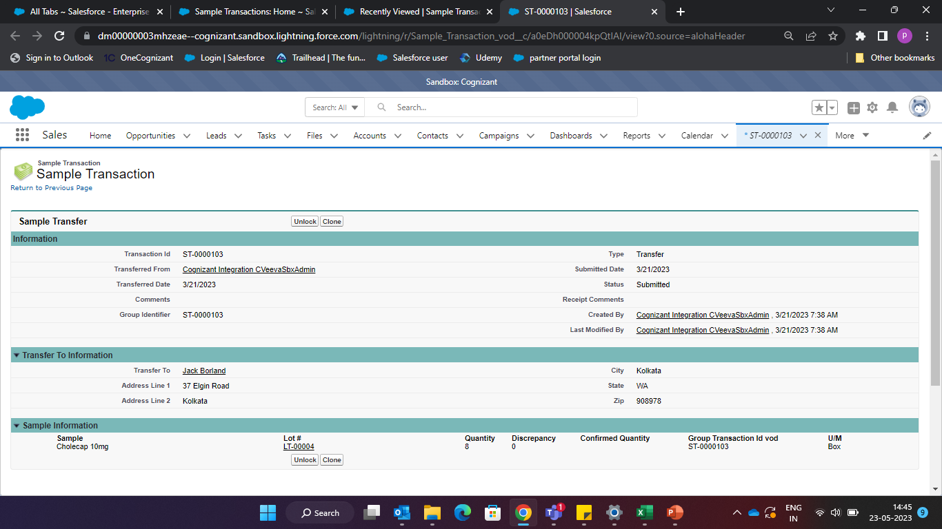
Transfer Sample To Users
Admin or user can transfer the samples to the users from his ‘My Samples’ tab

Slide 33
Receipt Sample Transactions…1
In case of a Sample Transfer, Receipt Sample Transactions represent a user’s Receipt of a Sample Lot. The Receipt Sample Transaction is created on the Confirmation of a Sample Receipt record
Similarly, a Receipt Sample Transaction record can be created for a Sample Receipt record created as a part of a 3rd party integration
Ref Transaction Id in a Receipt Sample Transaction record contains the reference to the Sample Transaction record for which the Receipt was created
In case of a Receipt Sample Transaction created by a 3rd party integration, the Ref Transaction Id is not populated
On confirmation of a Sample Receipt record the following happens:
  A Receipt Sample Transaction is created for the user
  The Received Check box, Receipt Comments, Ref Transaction Id and Confirmed Quantity fields are populated on the Transfer Sample Transaction record

Slide 34
Receipt Sample Transactions…2
The DISABLE_SAMPLE_RECEIPT_DEFAULT VEEVA Setting governs whether the Quantity field on Sample Receipt record will be defaulted or user is required to enter the Quantity manually
Note:
  Read, Edit and Create permissions to the Sample_Receipt_vod object need to be provided to users to confirm receipt of Sample and to send a Sample Receipt

Slide 35
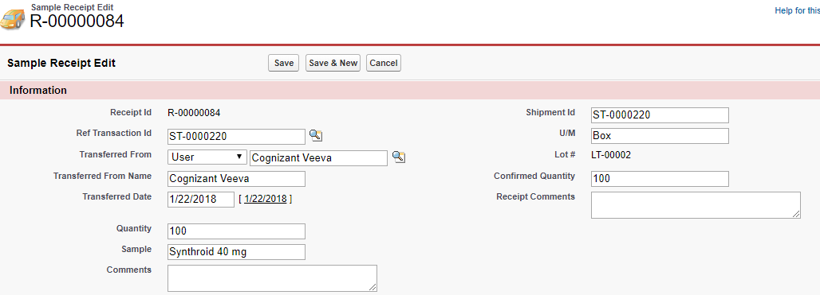
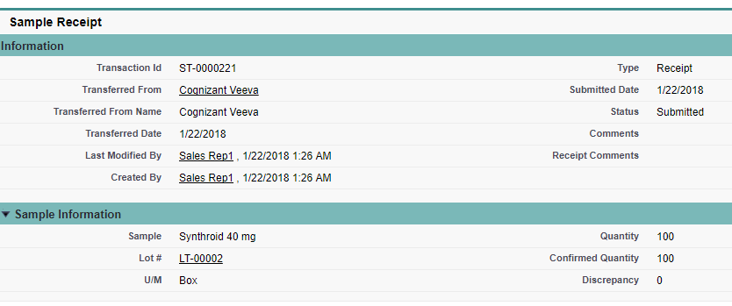
Receipt Sample Transactions…3
User confirms the Sample receipt record by inputting the Confirmed Quantity
Receipt Sample Transaction record is created after user submits the Sample Receipt confirmation
© Cognizant 2015

Slide 36
Disbursement Sample Transactions
Whenever a Sample Drop happens, that is, samples have been added to a Call, a Sample Disbursement Transaction record is created
This Disbursement Transaction record is created by an Apex trigger whenever a Call is submitted where Sample(s) has been selected
A disbursement record is created for each sample added to the call
A Disbursement Sample Transaction is created for both paper-based Sampling as well as Electronic Signature Sampling from the VEEVA CRM application

Slide 37
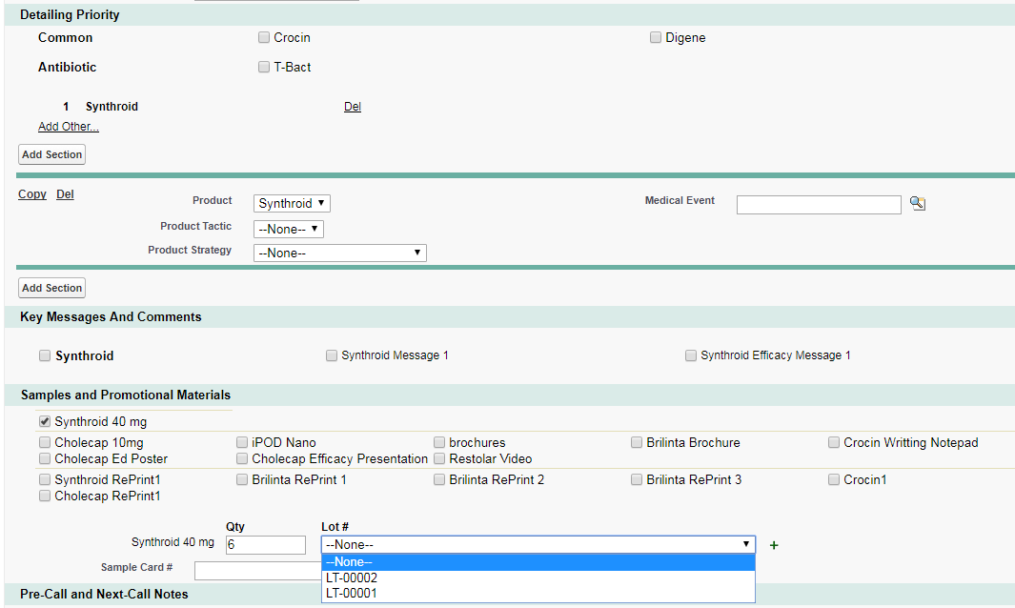
User Records a Call with Samples
After all the changes are done, user can create a call with HCP with Samples
© Cognizant 2015
37

Slide 38
Return Sample Transactions…1
Sometimes due to certain scenarios where Samples have expired or got damaged the Sales Representatives require to return the Samples
In VEEVA CRM, users can create a Sample Transaction from ‘My Samples’ tab. This will create a sample transaction record with record type as Return_vod in order to capture the return of samples
The Return to recipient field is a required information in a Return Sample Transaction record. The return address is auto-populated based on the selection of destination
Return addresses are stored in the Rep Roster. The Return to pick list values must match the Username External ID field in Rep Roster object in order to populate the return address

Slide 39
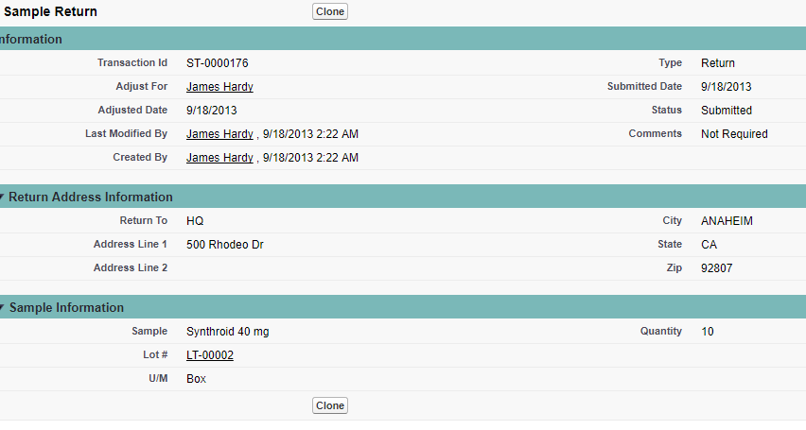
Return Sample Transactions…2
Below is an example of Sample return made by the sales representative:

Slide 40
Adjustment Sample Transactions…1
In case a Sample Lot has been lost or stolen a Sample Adjustment can be recorded by the user
Reasons picklist in an Adjustment Sample Transaction record is used to provide a reason for the adjustment
These transactions correspond to a user’s needs to adjust the Calculated Quantity of a Sample Lot. Reason
The Quantity field for an Adjustment Sample Transaction can be greater than, less than, or equal to zero
However, validation rules can be applied in order to incorporate business logic such that the Quantity cannot be less than 1
The value entered for the Quantity is the direct value that the Adjustment Sample Transaction will have on the Calculated Quantity for the Sample Lot

Slide 41
Adjustment Sample Transactions…2
Key areas of administration:
  Reason picklist values
  Validation rules for adjustments
  Accessibility of Sample Lot records for Adjust for functionality
Note:
  A user can create an Adjustment on behalf of another user by utilizing the Adjust for field
  However, this is governed by the fact that the user should have access to Sample Lot data of the user on whose behalf the Adjustment Transaction record needs to be created
  Uses can create a backdated Adjustment Sample Transaction by utilizing the Adjusted Date field

Slide 42
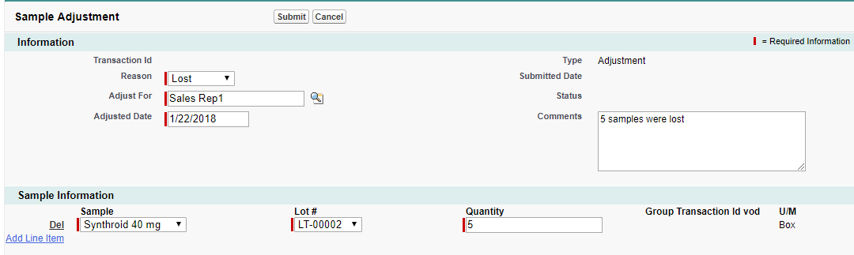
Adjustment Sample Transactions…3
Below is an example of sample adjustment made by sales representative:

Slide 43
Sample Management in VEEVA
Sample Limit
20-07-2023

Slide 44
Sample Limits…1
Sample Limits provide a method to regulate and enforce the Sample Quantity disbursed
The number of samples disbursed to an Account over a specific time period is regulated by several companies
This feature is available in both online and offline
For a given product, the limits can be applied at the following levels:
  Account Limit
    Limiting the sample quantity that can be disbursed over a period of time to a particular Account
    It is applicable to a specific Account across all Users

Slide 45
Sample Limits…2
  User Limit
    Limiting the sample quantity that can be disbursed over a period of time by a particular user
    It is applicable to a specific user across all Accounts
  Account-User Limit
    Limiting the sample quantity that can be disbursed over a period of time to a particular Account by a particular user
    It is applicable to a specific user for a specific Account
  Limit Per Call
    Specific amount of sample quantity that can be disbursed over a single call

Slide 46
Check Your Understanding ... 1
1. In order to provide user the permission to use the Create Sample Lots button effectively, user should be given access to which of the following?
Visualforce page CreateSampleLots_vod
The Apex Class VOD_GetRecordIds
Visualforce page CreateSampleLots
Both I and II
Answer: Both I and II

Slide 47
Check Your Understanding ... 2
2.The Sample Lot object has a master-detail relationship with the Sample Transactions object in the detail side.
State True or False
True
False
Answer: True

Slide 48
Check Your Understanding ... 3
3. Sample Limit cannot be applied on which of the following levels?
Account
User
Product
Call
Answer: Product

Slide 49
Check Your Understanding ... 4
4. Which of the following is not a type of Sample Transaction in VEEVA CRM?
Return
Disbursement
Receipt
None of the above
Answer: None of the above

Slide 50
Check Your Understanding ... 5
5. A user can create an Adjustment on behalf of another user by utilizing the Adjust for field. State True or False
True
False
Answer: True

Slide 51

Summary
In this module, you have learnt to:
  Define VEEVA Sample Management Data Model
  Define Sample Lot and Lot Catalog
  Explain various Sample Transactions
  Describe My Samples Tab
  Describe Sample Limit

Slide 52
Source
https://crmhelp.VEEVA.com/doc
Disclaimer: Parts of the content of this course is based on the materials available from the Web sites and books listed above. The materials that can be accessed from linked sites are not maintained by Cognizant Academy and we are not responsible for the contents thereof. All trademarks, service marks, and trade names in this course are the marks of the respective owner(s).

Slide 53
Coming Next ...
In the upcoming module - Territory Management, you will learn to:
  Define VEEVA Data Model – Account Visibility/Territory Alignment & Territory Hierarchy
  Create Territories
  Define VEEVA’s Account Territory Loader (ATL)
  List out ATL Best Practice
  Describe Zip-to-Terr & Brick-to-Terr
  Work with Territory Fields - Product Alignment by Territory and Account

Slide 54
Thank you
  You have successfully completed
  Sample Management in VEEVA

